Slide 1
DEV-1545 Beyond Domino Designer

Slide 2
Please note
IBM’s statements regarding its plans, directions, and intent are subject to change or withdrawal without notice at IBM’s sole discretion.
Information regarding potential future products is intended to outline our general product direction and it should not be relied on in making a purchasing decision.
The information mentioned regarding potential future products is not a commitment, promise, or legal obligation to deliver any material, code or functionality. Information about potential future products may not be incorporated into any contract.
The development, release, and timing of any future features or functionality described for our products remains at our sole discretion.
Performance is based on measurements and projections using standard IBM benchmarks in a controlled environment. The actual throughput or performance that any user will experience will vary depending upon many factors, including considerations such as the amount of multiprogramming in the user’s job stream, the I/O configuration, the storage configuration, and the workload processed. Therefore, no assurance can be given that an individual user will achieve results similar to those stated here.

Slide 3

Agenda
Lots of naked code included!

Slide 4

Agenda
What, Why, How
The tools
Developer Workflow
Demo
Q & A
Agenda

Slide 5
What, Why, How

Slide 6
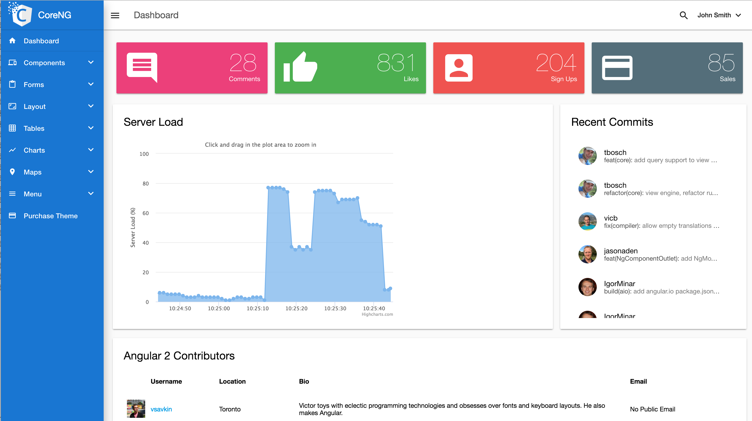
What
Deliver modern looking web & mobile applications, that are:
Well tested
Familiar to use
Frequently updated
Maintainable by “typical web developers”

Slide 7

Why

Slide 8

If you are a Hobbit - maybe
Why
Source: http://kingofwallpapers.com/gandalf/gandalf-004.jpg

Slide 9
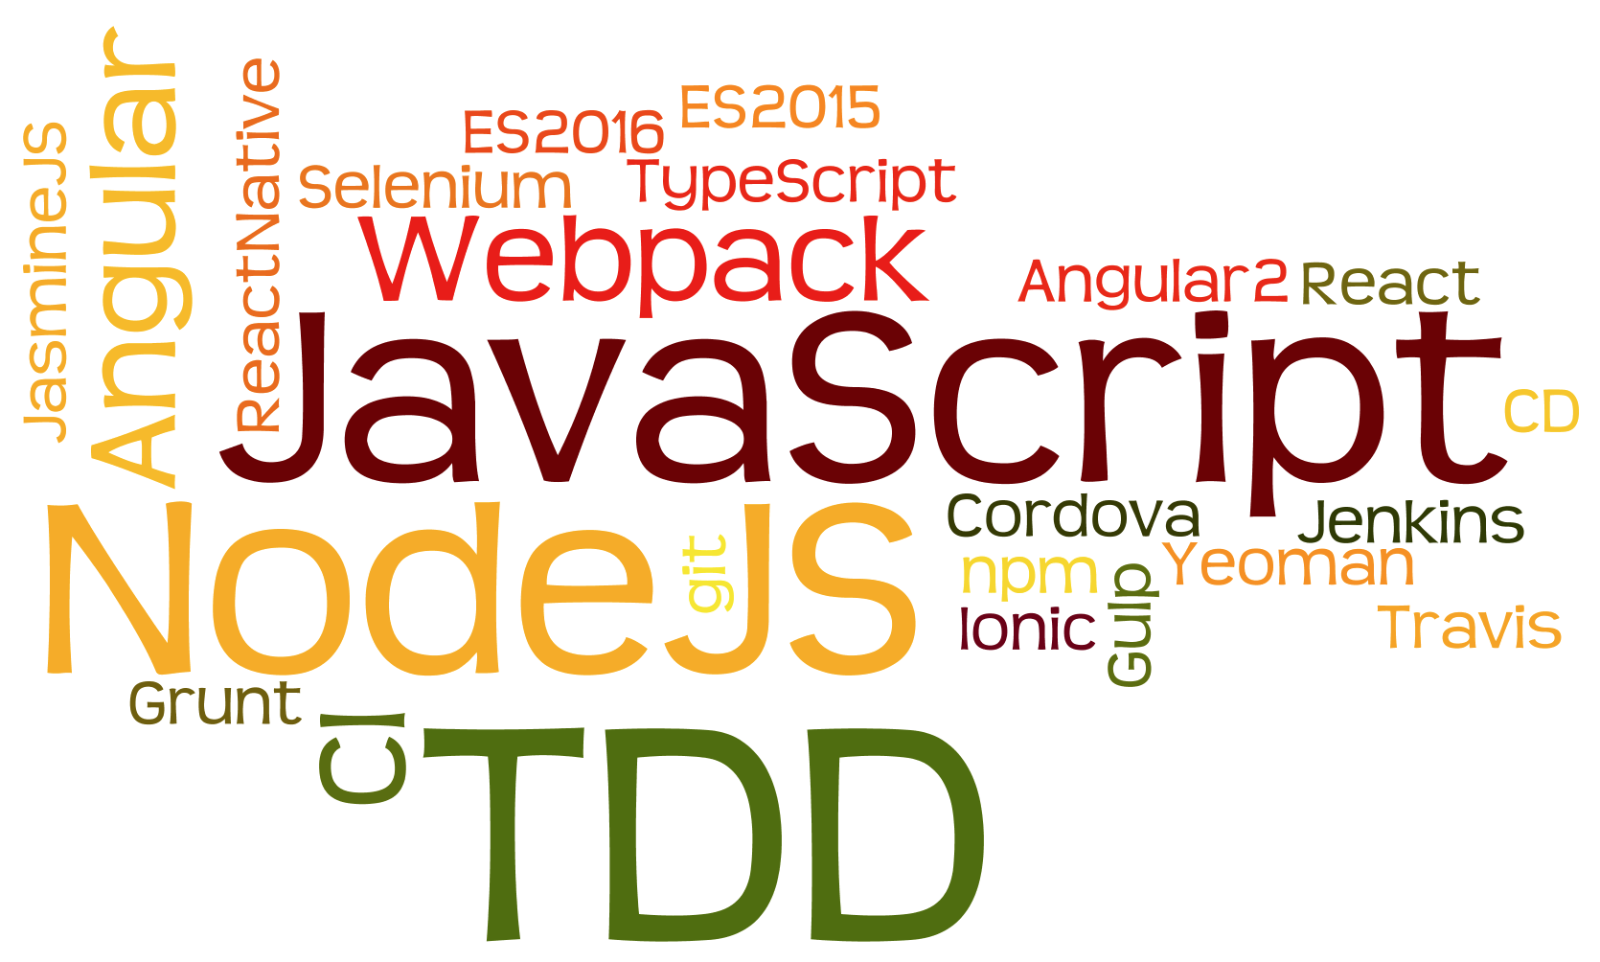
Why
http/2

Slide 10

Ideas

Slide 11
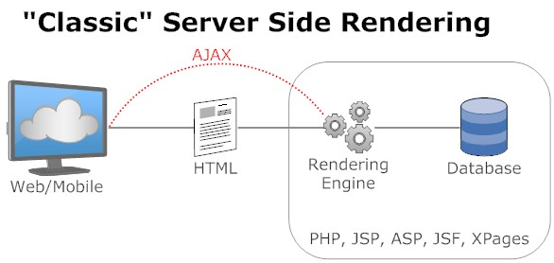
What we have been doing
Why

Slide 12
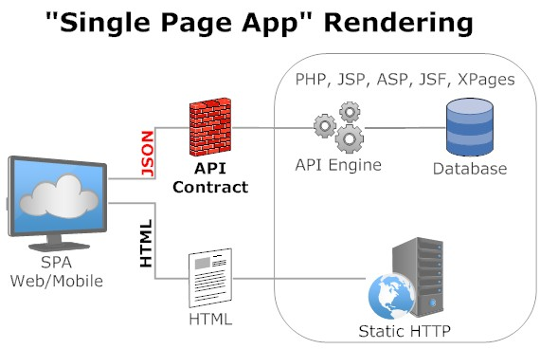
The current fashion
Why

Slide 13

Rethink development language
Domino
Forms
Views
Actions
Agents
Single Page Apps
Routes
Services
Views
List of Documents in a database
UI rendering as result of a route
Don’t confuse Domino views and SPA views!
How

Slide 14
The tools

Slide 15
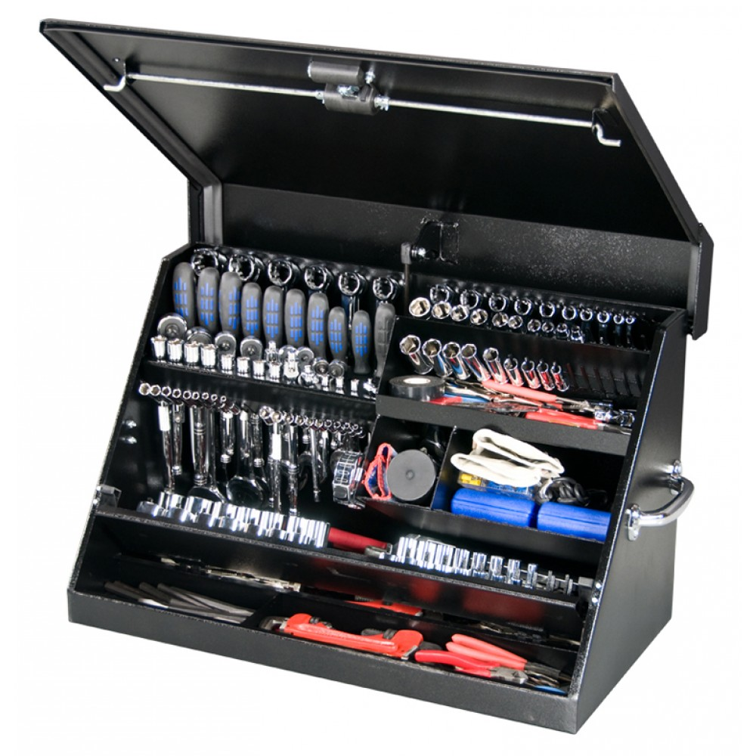
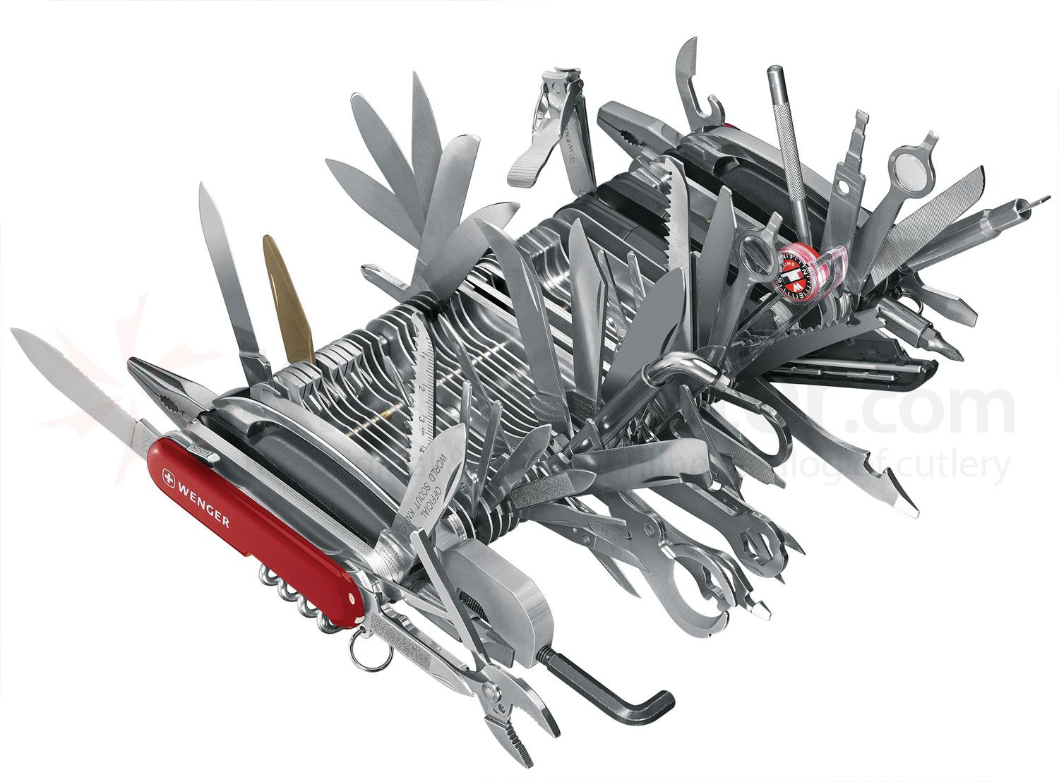
Developer Toolbox vs. Domino Designer
Why
Why
Source: http://www.strictlytoolboxes.com/
Source: https://www.knifecenter.com/

Slide 16
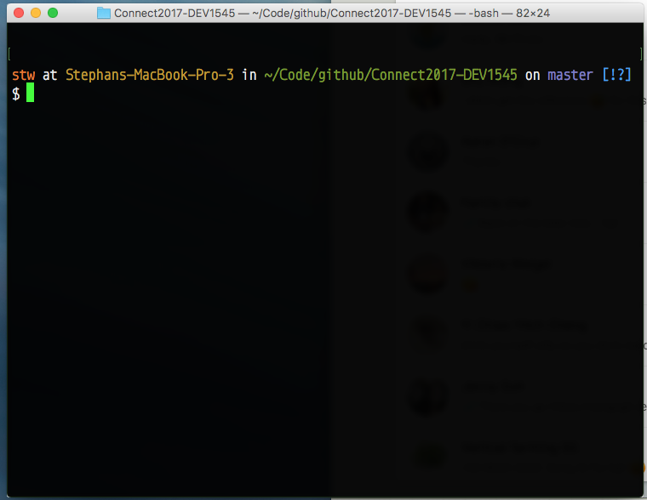
And there came along….
Install
node.js
https://nodejs.org
(currently 6.9.4 LTS)
… and …
make friends with
npm
we take it from there
Command line irony
How
How

Slide 17
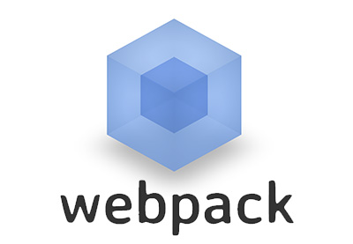




What – JavaScript tooling
NodeJS
Webpack
Wallaby
Angular
Npm / yarn
Postman
Tooling

Slide 18
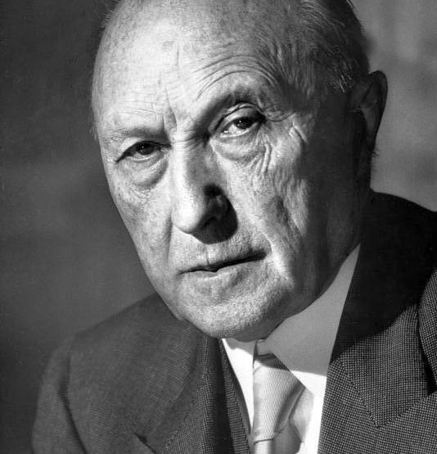
A word on tooling
By Konrad Adenauer German Chancellor 1949 – 1963 “Was interessiert mich mein Geschwätz von gestern”
Tooling
Source: By Bundesarchiv, B 145 Bild-F078072-0004 Katherine Young CC-BY-SA 3.0, CC BY-SA 3.0 de https://commons.wikimedia.org/w/index.php?curid=5356485

Slide 19


Update speed of core and packages
vs.
© Disney Inc
Tooling
© Dreamworks Studios

Slide 20
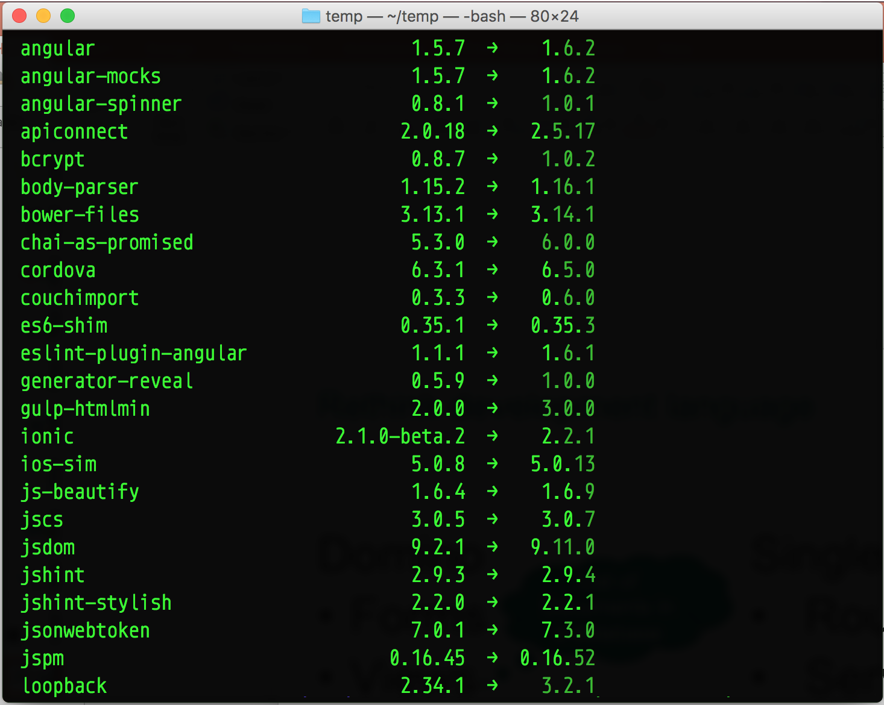
npm install –g npm-check-updates
ncu –g
Tooling

Slide 21
Developer workflow

Slide 22




What – Development flow
Project Structure
Version Control
Testing
Lots of testing
Tooling

Slide 23
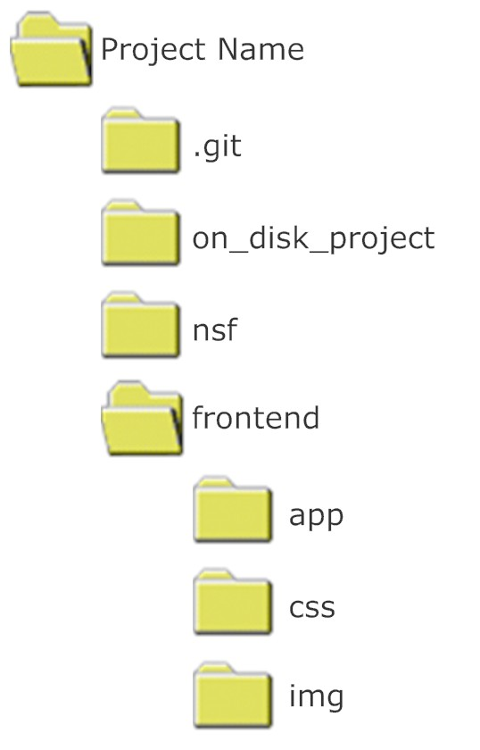
Project structure – single .git
.gitignore
.DS_Store
*.nsf
Desktop.ini
.Spotlight-V100
.Trashes
Thumbs.db
You might want to separate the repositories for front and back end
How

Slide 24
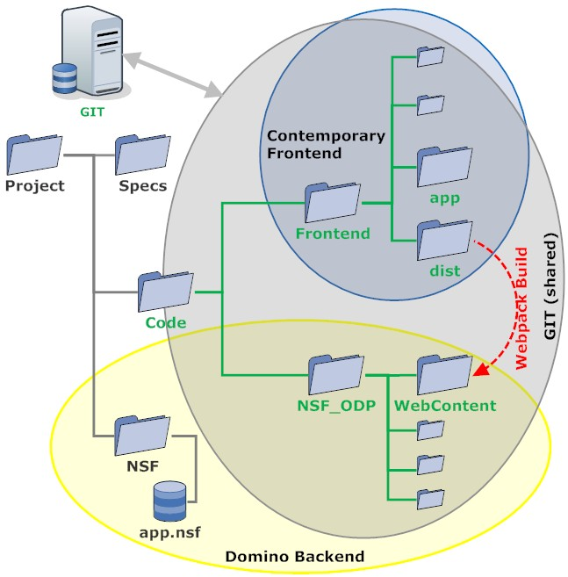
Deployment
Option 1
How

Slide 25
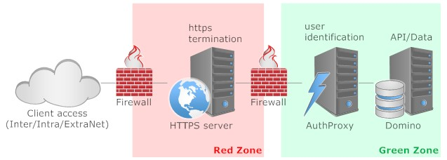
Deployment
Option 2
How

Slide 26
Comparing deployment options
Single NSF
Easy deployment
Domino HTTP stack
Domino authentication
Single tier
Front-end / Back-end split
Easy update of frontend
http2 capable
Any authentication
Multi tier
There is no “one perfect solution”, only choices and consequences
How

Slide 27
Client - Server API
What I want to send/receive to/from the server:
{ "color" : "green",
"taste" : "sour",
"name" : "Apple"
}
JSON rulez supreme!
XML is out of fashion
x-www-form-urlencoded
Is kind of lame
How

Slide 28
Backend options
Agents (if you are still on LotusScript)
XAgents (hardcore SSJS)
Just views (read only)
XPages Rest controls
Domino Access Services
Custom servlets (Wink or otherwise)
SmartNSF (highly recommended!!!)
External Java8 (I like vert.x)
Pro tip:
Be lean on your API
There is no “one perfect solution”, only choices and consequences
How

Slide 29
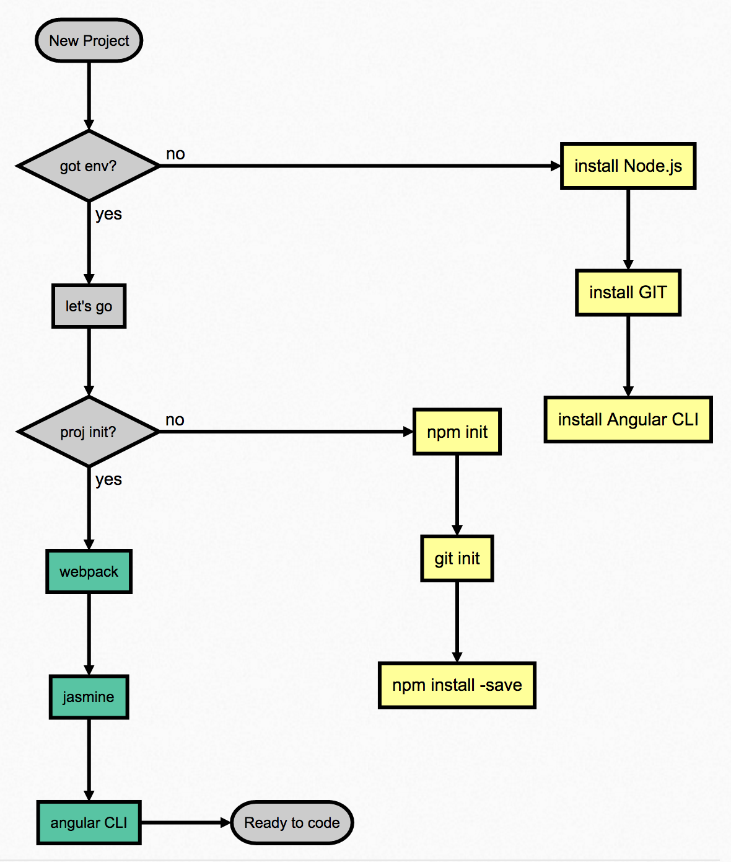
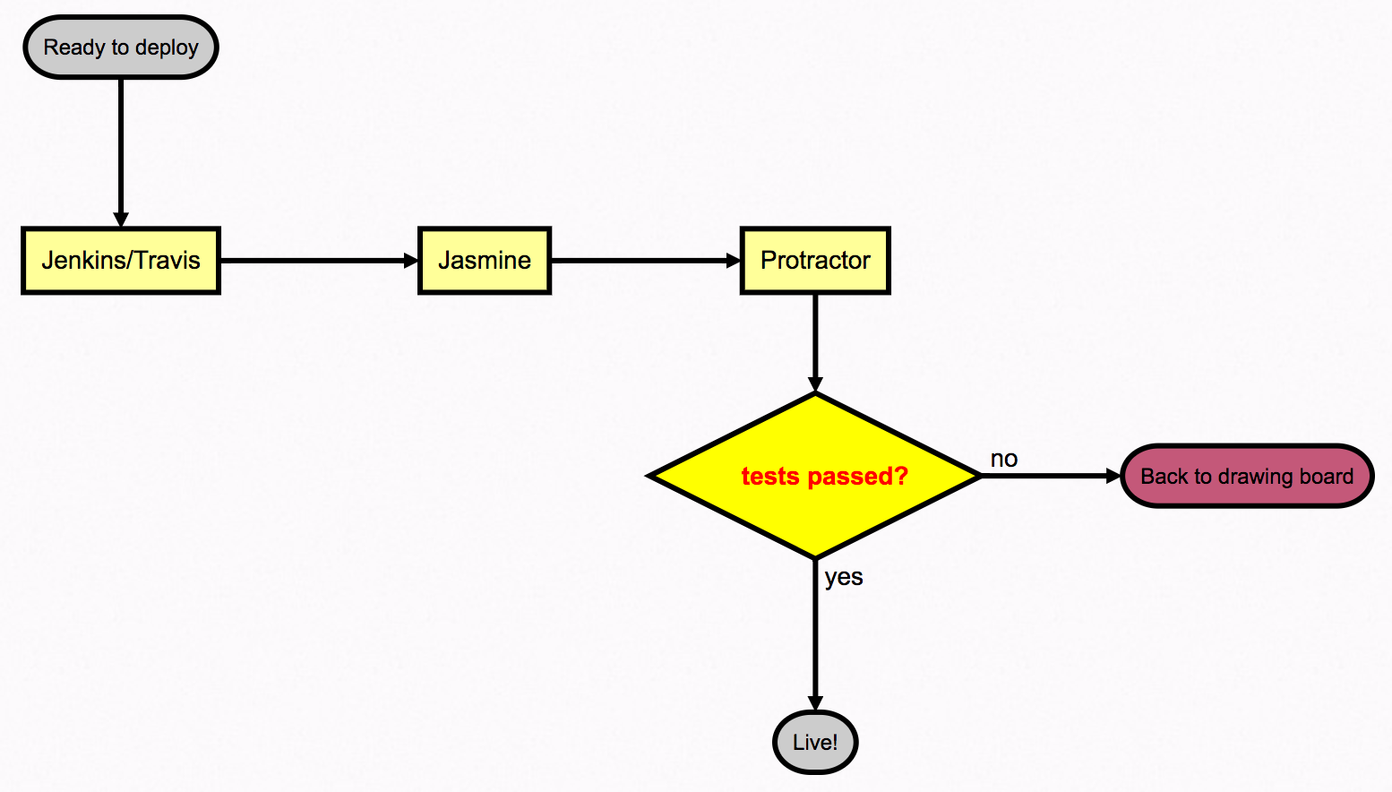
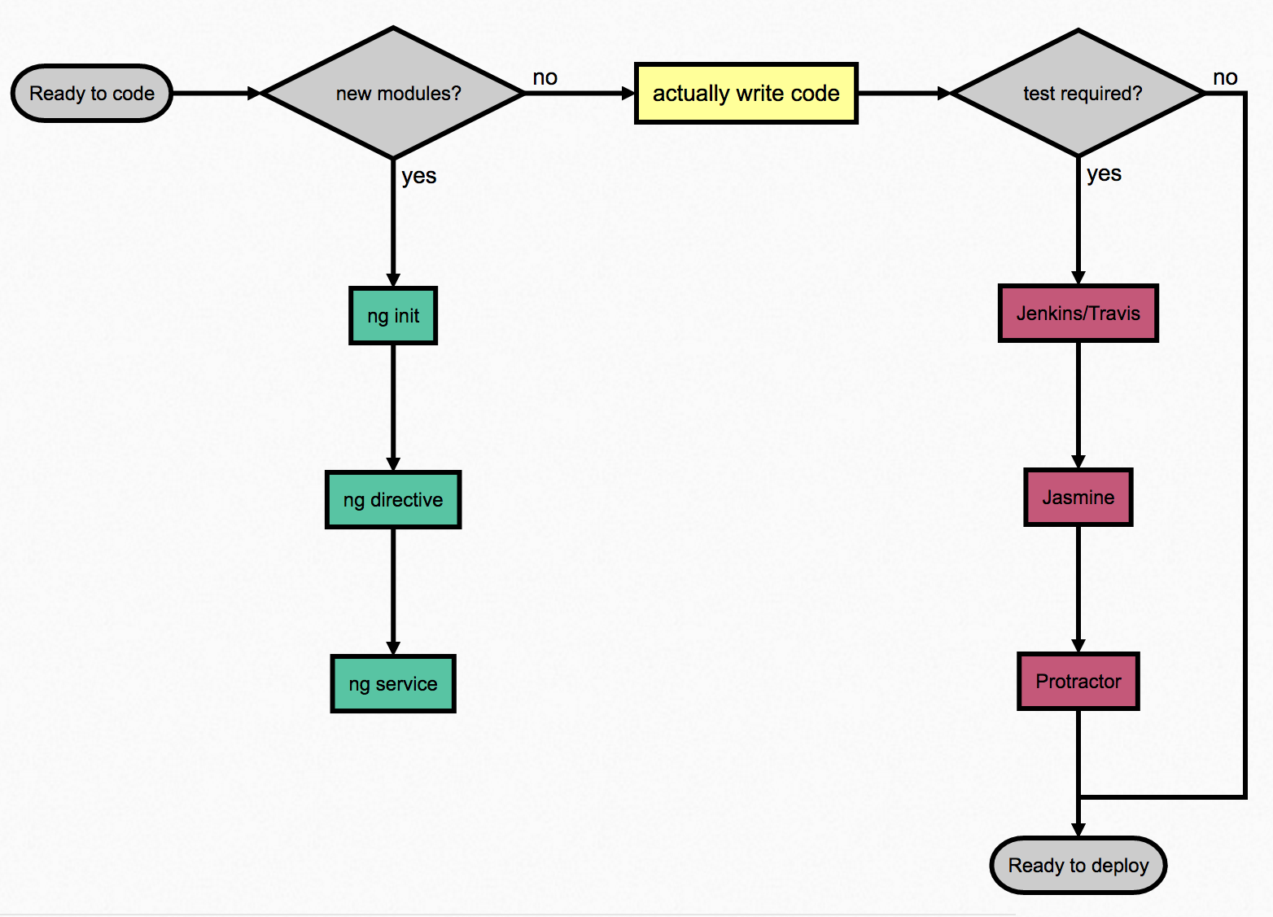
Developer workflow
Easy as 1-2-3
Scaffold
Code
Deploy
How

Slide 30
Put Domino into CI?
Pro:
Fresh start
Known state
Con:
Heavy operation
NSF updates hard
Key consideration:
Do you have date sensitive operations?
New documents arrived
Documents changed
Test design!
How

Slide 31
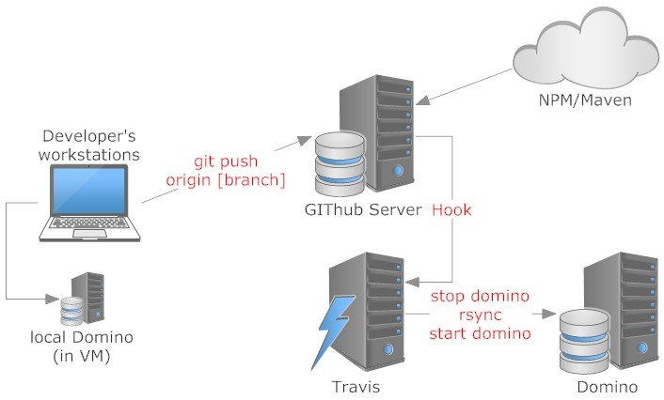
A potential setup
3 Projects:
OSGi plugins (incl. NSF)
Front-End
End-2-End test
How

Slide 32
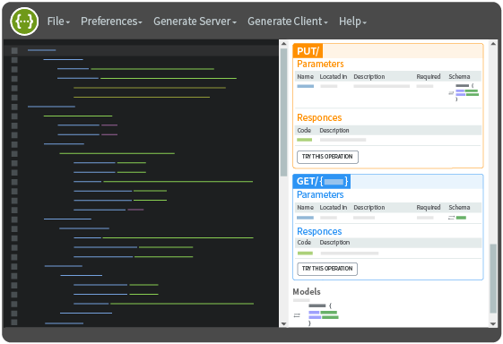
Data model
Classic Domino
Forms
Views
API Driven Web applications:
Swagger
Data model
Action model
Code generation
How

Slide 33
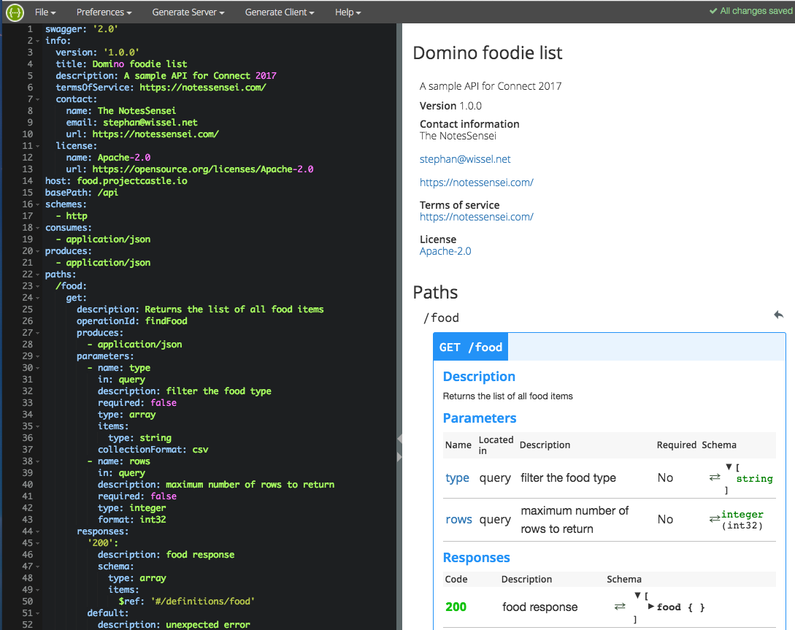
Our
Swagger
model
How

Slide 34
Swagger Model
definitions:
food:
type: object
required:
- name
properties:
id:
type: string
name:
type: string
taste:
type: string
color:
type: string
shape:
type: string
type:
type: string
How

Slide 35
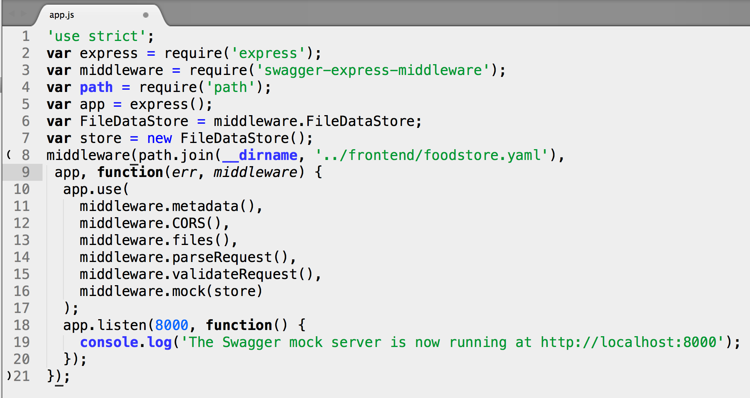
Mock server to keep the front-end guys happy
How

Slide 36
Planning the Angular FrontEnd
Quick planning, refactor later
Plan routes
One per view
Subroutes for documents
Plan “Views”
One per view
One per document
That’s just to get you started. Once you are comfortable, refactor!
How

Slide 37
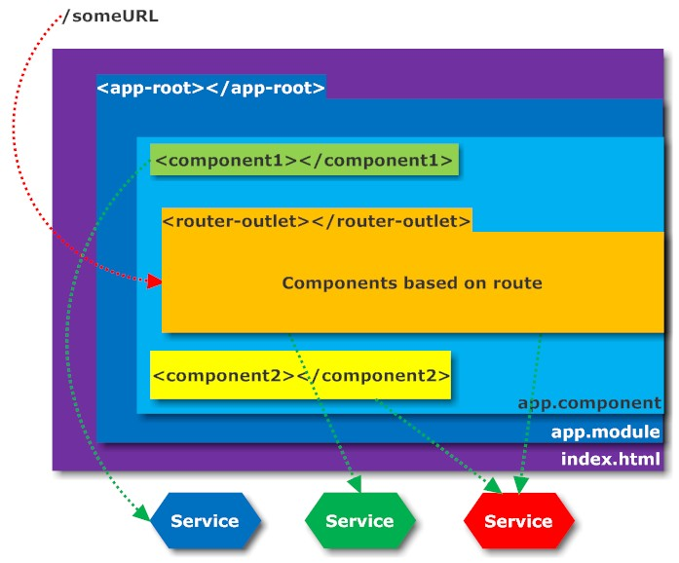
Learn more here:
http://blog.angular-university.io/
Anatomy of an Angular App
How

Slide 38
Testing – double the work, a magnitude less headache
OOTB: errors are reported on command line only
Better reporting tool (1): npm install --save-dev karma-mocha-reporter add require('karma-mocha-reporter') to plugins in karma.conf.js and reporters: ['mocha']
Better reporting tool (2): npm install –-save-dev karma-htmlfile-reporter add require(‘karma-htmlfile-reporter’) to plugins in karma.conf.js and reporters: ['mocha’,’html']
For CI consider JUNIT report format. Integrates best with most CI reports
How

Slide 39
Demo

Slide 40

All this command line stuff vs. Designer
Code Whisperers don’t need a fancy GUI. They talk to the command line
Tooling
Source: https://en.wikipedia.org/wiki/Control_of_fire_by_early_humans

Slide 41
Testing – some insights
You will edit your spec files frequently
Each new component needs to be added to spec
Mocks are a code smell (could be fragrant or stinky) – use them wisely for services!
Consider https://wallabyjs.com/ to continuously run your tests while typing*
Providers can be tricky (consider Mocks for some)
{provide: Router, useClass: RouterModule}
{provide: Http, useClass: HttpModule}
Takes quite some getting used to
How
* bad when on battery

Slide 42
In Summary
Contemporary web development requires node.js as tooling
Version control is your friend
Make peace with the command line: npm, ng, git, travis …
Http knowledge required. Use POSTMAN for convenience
Separate front-end and back-end with a strong API
Continuous integration & Test Driven development rule
There is a lot to learn in new world of web development
How

Slide 43
Questions?
https://github.com/Stwissel/connect2017-dev1545
Thank you!

Slide 44
Notices and disclaimers
Copyright © 2017 by International Business Machines Corporation (IBM). No part of this document may be reproduced or transmitted in any form without written permission from IBM.
U.S. Government Users Restricted Rights — Use, duplication or disclosure restricted by GSA ADP Schedule Contract with IBM.
Information in these presentations (including information relating to products that have not yet been announced by IBM) has been reviewed for accuracy as of the date of initial publication and could include unintentional technical or typographical errors. IBM shall have no responsibility to update this information. THIS DOCUMENT IS DISTRIBUTED "AS IS" WITHOUT ANY WARRANTY, EITHER EXPRESS OR IMPLIED. IN NO EVENT SHALL IBM BE LIABLE FOR ANY DAMAGE ARISING FROM THE USE OF THIS INFORMATION, INCLUDING BUT NOT LIMITED TO, LOSS OF DATA, BUSINESS INTERRUPTION, LOSS OF PROFIT OR LOSS OF OPPORTUNITY. IBM products and services are warranted according to the terms and conditions of the agreements under which they are provided.
IBM products are manufactured from new parts or new and used parts. In some cases, a product may not be new and may have been previously installed. Regardless, our warranty terms apply.”
Any statements regarding IBM's future direction, intent or product plans are subject to change or withdrawal without notice.
Performance data contained herein was generally obtained in a controlled, isolated environments. Customer examples are presented as illustrations of how those customers have used IBM products and the results they may have achieved. Actual performance, cost, savings or other results in other operating environments may vary.
References in this document to IBM products, programs, or services does not imply that IBM intends to make such products, programs or services available in all countries in which IBM operates or does business.
Workshops, sessions and associated materials may have been prepared by independent session speakers, and do not necessarily reflect the views of IBM. All materials and discussions are provided for informational purposes only, and are neither intended to, nor shall constitute legal or other guidance or advice to any individual participant or their specific situation.
It is the customer’s responsibility to insure its own compliance with legal requirements and to obtain advice of competent legal counsel as to the identification and interpretation of any relevant laws and regulatory requirements that may affect the customer’s business and any actions the customer may need to take to comply with such laws. IBM does not provide legal advice or represent or warrant that its services or products will ensure that the customer is in compliance with any law

Slide 45
Notices and disclaimers continued
Information concerning non-IBM products was obtained from the suppliers of those products, their published announcements or other publicly available sources. IBM has not tested those products in connection with this publication and cannot confirm the accuracy of performance, compatibility or any other claims related to non-IBM products. Questions on the capabilities of non-IBM products should be addressed to the suppliers of those products. IBM does not warrant the quality of any third-party products, or the ability of any such third-party products to interoperate with IBM’s products. IBM EXPRESSLY DISCLAIMS ALL WARRANTIES, EXPRESSED OR IMPLIED, INCLUDING BUT NOT LIMITED TO, THE IMPLIED WARRANTIES OF MERCHANTABILITY AND FITNESS FOR A PARTICULAR PURPOSE.
The provision of the information contained herein is not intended to, and does not, grant any right or license under any IBM patents, copyrights, trademarks or other intellectual property right.
IBM, the IBM logo, ibm.com, Aspera®, Bluemix, Blueworks Live, CICS, Clearcase, Cognos®, DOORS®, Emptoris®, Enterprise Document Management System™, FASP®, FileNet®, Global Business Services ®, Global Technology Services ®, IBM ExperienceOne™, IBM SmartCloud®, IBM Social Business®, Information on Demand, ILOG, Maximo®, MQIntegrator®, MQSeries®, Netcool®, OMEGAMON, OpenPower, PureAnalytics™, PureApplication®, pureCluster™, PureCoverage®, PureData®, PureExperience®, PureFlex®, pureQuery®, pureScale®, PureSystems®, QRadar®, Rational®, Rhapsody®, Smarter Commerce®, SoDA, SPSS, Sterling Commerce®, StoredIQ, Tealeaf®, Tivoli®, Trusteer®, Unica®, urban{code}®, Watson, WebSphere®, Worklight®, X-Force® and System z® Z/OS, are trademarks of International Business Machines Corporation, registered in many jurisdictions worldwide. Other product and service names might be trademarks of IBM or other companies. A current list of IBM trademarks is available on the Web at "Copyright and trademark information" at: www.ibm.com/legal/copytrade.shtml.

Slide 46
Further readings
Would you like to know more?*
* In case you didn’t get the reference: https://www.youtube.com/watch?v=kdrjzE1SE58

Slide 47
The full deck & all the files
The presentation & sample files:
https://github.com/Stwissel/connect2017-dev1545
The Swagger Codegen update:
https://github.com/Stwissel/swagger-codegen
Formly for Angular:
https://github.com/formly-js/ng-formly
Reference

Slide 48
Tool locations
Node.js: https://nodejs.org/
NPM: https://www.npmjs.com/
Jasmine: https://jasmine.github.io/
Protractor: https://www.protractortest.org/
AngularJS: https://angular.io/
Angular CLI: https://cli.angular.io/
TypeScript: https://www.typescriptlang.org/
Webpack: https://webpack.js.org/
Microsoft Code: https://code.visualstudio.com/
Swagger: http://swagger.io/
Wallaby: https://wallabyjs.com/
Postman: https://www.getpostman.com/
GIT: https://git-scm.com/
Tower: https://www.git-tower.com/
Sourcetree: https://www.sourcetreeapp.com/
Mustache: https://mustache.github.io/
Reference

Slide 49
Developer workflow (1/3)
Reference

Slide 50
Developer workflow (2/3)
Reference

Slide 51
Developer workflow (3/3)
Reference

